Slide 1
NORTH SOUTH UNIVERSITY
Lecture 9
PHI 104
Introduction to Ethics

Slide 2
Medical Ethics:
Beginning of Life Issues

Slide 3
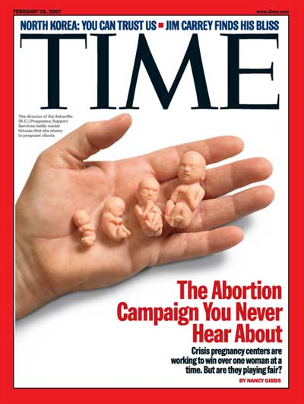

Slide 4
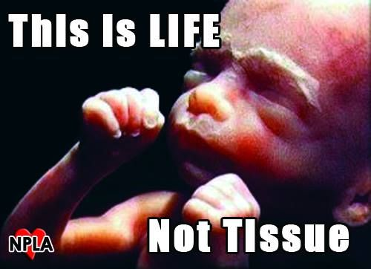

Slide 5
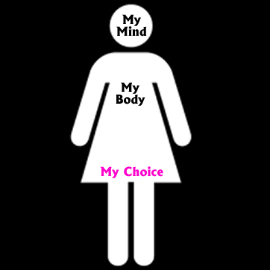

Slide 6
Bioethical issues related to Beginning of Life–Family planning, Abortion, prenatal testing, Assisted reproductive technology
Bioethical issues concerning End of Life–Euthanasia, Withdrawing and with holding treatment, Assisted suicide
Bioethical concerns related to sustaining Quality of Life – Organ and tissue Transplantation, Genetic engineering, human cloning

Slide 7
Ethical Issues-Family Planning
Refers to the various methods used to control the size of one’s family or to space birth.
The religious, beliefs and personal values of individuals usually influence the methods and approaches used.

Slide 8
Prenatal Testing
Sonography and other techniques to detect genetic abnormalities.
Ethical concern:
Govt. may make amniocentesis n abortion of all defective fetuses mandatory.
Couples may be stressed as carrying defective gene.

Slide 9
Assisted Reproductive Technology (ART)
The IVF technology is a boon to childless couples.
The purpose of this procedure is to achieve fertilization and pregnancy.
The first IVF baby - Louse Joy Brown, who was born on July 25, 1978.

Slide 10
Ethical Issues
Woman may have multiple births as several fertilized ova are developed to ensure that at least one will survive.
At times this lead to abortion leading to financial and emotional costs.
What to be done with fertilized ova that are not successful?
Donate, freeze (how long) or thrown away (abortion)?

Slide 11
ABORTION

Slide 12
Ethical Issues-Abortion
Abortion was legalized in 1973, but the topic remains controversial.
The central ethical question in the abortion debate is over the moral status of the embryo and fetus.

Slide 13
Opinions range from the belief that the fetus is a human being with full moral status and rights from conception to the belief that a fetus has no rights, even if it is human in a biological sense. Most Americans’ beliefs fall somewhere in the middle.

Slide 14
Moral philosophers from various perspectives provide nuanced examinations of the abortion question that go beyond the standard political breakdowns.

Slide 15
Abortion has been the subject of much ethical thought from both pro-life and pro-choice perspectives. The central philosophical question concerns the moral status of the embryo and fetus. If the fetus is a person, with the same right to life as any human being who has been born, it would seem that very few, if any, abortions could be justified, because it is not morally permissible to kill children because they are unwanted or illegitimate or disabled.

Slide 16
However, the morality of abortion is not necessarily settled so straightforwardly. Even if one accepts the argument that the fetus is a person, it does not automatically follow that it has a right to the use of the pregnant woman’s body. Without that right, as Judith Thomson has argued, abortion could be justified.

Slide 17
Ethical Considerations
Public opinion on abortion falls into three camps—conservative, liberal, and moderate (or gradualist)—each of which draws on both science and ethical thinking.

Slide 18
Conservative’s Argument
(Pro-life)
Conservative
Conservatives regard the fetus as a human being, with the same rights as any human being who has been born, from implantation (when a pregnancy begins) onward. Some conservative groups—such as the Catholic Church—consider the fetus to be a human being with full moral rights even earlier, from conception onward.

Slide 19
Conception is regarded as the significant point because that is when the embryo develops its own unique genetic code, distinct from that of its mother or father, and thus from the egg or sperm.

Slide 20
The fetus changes dramatically during gestation but, on the conservative view, no stage is ever reached at which we can say, now we have a human being, whereas a day or a week or a month earlier we did not. Any attempt to place the onset of humanity at a particular moment—whether it be when brain waves appear, or the human form becomes distinct, or at quickening, sentience, or viability—is bound to be arbitrary because all of these stages will occur if the fetus is allowed to grow and develop.

Slide 21
Liberals Argument
(Pro-choice)
Most liberals acknowledge that the fetus is human in a biological sense, but deny that this endows the fetus with full moral status or a right to life. In 1971, Judith Thomson gave a completely different pro-choice argument, claiming that even if the personhood of the fetus were granted, this would not settle the morality of abortion because the fetus’s right to life does not necessarily give it a right to use the pregnant woman’s body.

Slide 22
No one, Thomson says, has the right to use your body unless you give him permission—not even if he needs it for life itself. At least in the case of rape, the pregnant woman has not given the fetus the right to use her body.

Slide 23
Judith Thomson, “A Defense of Abortion,” Philosophy and Public Affairs, Winter 1971
Thomson maintains that whether a woman ought to allow a fetus to remain in her body is a separate question from whether the fetus is a person with a right to life, and depends instead on the amount of sacrifice or burden it imposes on her.

Slide 24
Thanks
THANK YOU!!!

